Slide 1
C# Extension Methods
Presented By : Meet Patel

Slide 2
Outline
What are Extension Methods in C#
Advantages / Cons
Extension Methods Some Rules to Know
Example

Slide 3
What is Extension Methods in C#
Additional Methods
Extension methods allow you to inject additional methods without modifying, deriving or recompiling the original class, struct or interface.
Extension methods are static methods, but they're called as if they were instance methods on the extended type.

Slide 4
Advantages / Cons
Pros
Usability
The main advantage of the extension method is to add new methods in the existing class without using inheritance.
You can add new methods in the existing class without modifying the source code of the existing class.
It can also work with sealed class.
Code Readability
It’s easy to read
Separation of Structure
Keeps your classes and class dependencies clean
Cons
Namespace and Static
Must contain a namespace to call the extension methods and must have a static class. Also have using to relate to the file containing the methods.

Slide 5
Extension Methods Some Rules to Know
You don’t need to touch or mess with source code of existing class that contains methods already inside.
Must reference it by “using [namespace];”
Class needs to have static modifier implemented.
The first parameter of an extension method is known as the binding parameter which should be the name of the class to which the method has to be bound and the binding parameter should be prefixed with “this”.

Slide 6
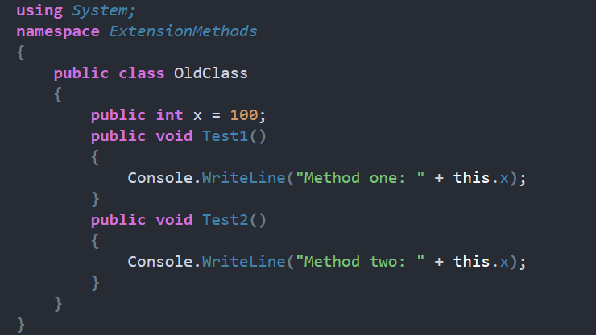
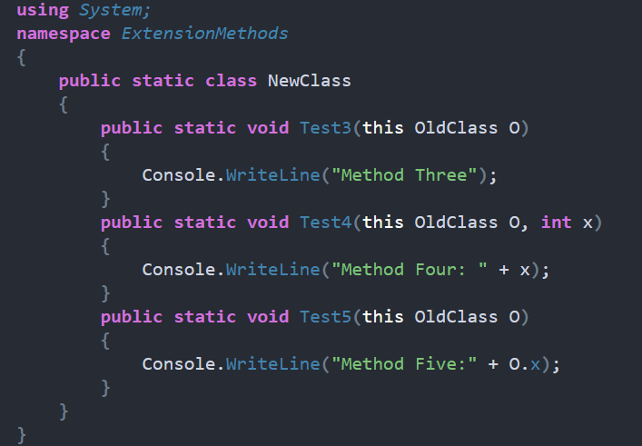
Example
Old Class
Can be untouchable
New Class
Adding new methods to extend from Old Class.

Slide 7
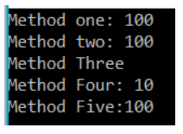
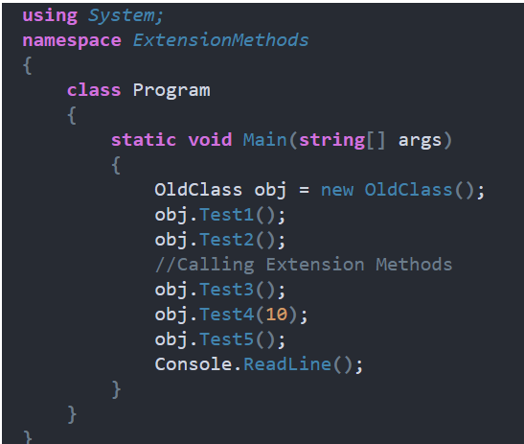
Example Cont.
Main Methods
Calling both Old Methods and new extended methods.
Output Console

Slide 8
References
https://dotnettutorials.net/lesson/extension-methods-csharp/
https://learn.microsoft.com/en-us/dotnet/csharp/programming-guide/classes-and-structs/extension-methods
https://www.tutorialsteacher.com/csharp/csharp-extension-method

Slide 9
Questions?

